Slide 1

Chicago Mafia
Nathan Clingman, Andrew Couch, Carter Hansen,
Jason Shanker

Slide 2





Agenda
Dataset Overview
Data Statistics
Issues and Resolution
Questions and Results
Challenges

Slide 3
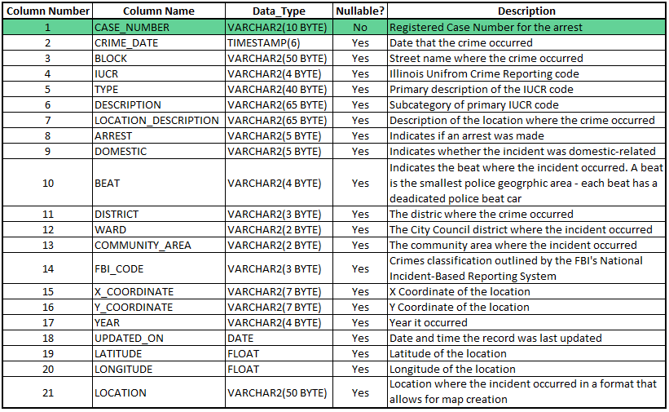
Chicago Crimes Database Information
# Rows: 6,928,228
36 Unique Primary types
Latitude and longitude has 66,959 missing values
20 years unique (2001 to 2020)
60,633 unique blocks
507 unique description
210 unique location description
24 unique districts
Notes:
Source: https://data.cityofchicago.org/Public-Safety/Crimes-2001-to-present/ijzp-q8t2

Slide 4
Schema
CREATE TABLE CHICAGO
( CASE_NUMBER VARCHAR2(10 BYTE) NOT NULL
, CRIME_DATE TIMESTAMP
, BLOCK VARCHAR2(50 BYTE)
, IUCR VARCHAR2(4 BYTE)
, TYPE VARCHAR2(40 BYTE)
, DESCRIPTION VARCHAR2(65 BYTE)
, LOCATION_DESCRIPTION VARCHAR2(65 BYTE)
, ARREST VARCHAR2(5 BYTE)
, DOMESTIC VARCHAR2(5 BYTE)
, BEAT VARCHAR2(4 BYTE)
, DISTRICT VARCHAR2(3 BYTE)
, WARD VARCHAR2(2 BYTE)
, COMMUNITY_AREA VARCHAR2(2 BYTE)
, FBI_CODE VARCHAR2(3 BYTE)
, X_COORDINATE VARCHAR2(7 BYTE)
, Y_COORDINATE VARCHAR2(7 BYTE)
, YEAR VARCHAR2(4 BYTE)
, UPDATED_ON DATE
, LATITUDE FLOAT(13)
, LONGITUDE FLOAT(13)
, LOCATION VARCHAR2(50 BYTE)
, CONSTRAINT CHICAGO_PK PRIMARY KEY (CASE_NUMBER));

Slide 5


Data Statistics
Total true and false for arrest
SELECT ARREST,COUNT(ARREST) AS TOTAL
FROM CHICAGO
GROUP BY ARREST;
Total true and false for domestic
SELECT DOMESTIC,COUNT(DOMESTIC) AS TOTAL
FROM CHICAGO
GROUP BY DOMESTIC;
Notes:
27.4% of crimes lead to an arrest. 13.3% of crimes are domestic

Slide 6
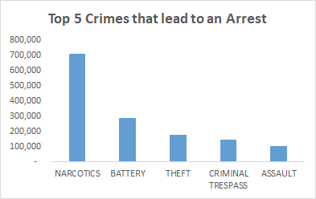
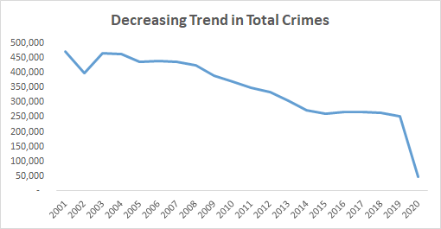
Data Statistics
Total Crimes by Year
SELECT YEAR,COUNT(YEAR)
FROM CHICAGO
GROUP BY YEAR
ORDER BY YEAR ASC;
Top 5 Crimes that lead to Arrests
SELECT*
FROM (SELECT TYPE, COUNT(ARREST) AS TOTAL_ARRESTS
FROM CHICAGO
WHERE ARREST='TRUE'
GROUP BY TYPE
ORDER BY TOTAL_ARRESTS DESC)
WHERE ROWNUM <= 5;
Notes:
Make note about 2020 data not being complete

Slide 7
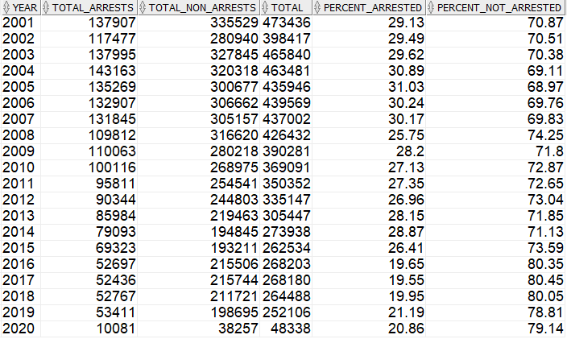
Data Statistics
Arrest Data by Year
SELECT YEAR,SUM( CASE WHEN ARREST LIKE '%TRUE%' THEN 1 ELSE 0 END) AS TOTAL_ARRESTS,
SUM(CASE WHEN ARREST LIKE '%FALSE%' THEN 1 ELSE 0 END) AS TOTAL_NON_ARRESTS, ROUND(SUM( CASE WHEN ARREST LIKE '%TRUE%' THEN 1 ELSE 0 END)+SUM(CASE WHEN ARREST LIKE '%FALSE%' THEN 1 ELSE 0 END),2) AS TOTAL,ROUND(SUM( CASE WHEN ARREST LIKE '%TRUE%' THEN 1 ELSE 0 END)/(SUM( CASE WHEN ARREST LIKE '%TRUE%' THEN 1 ELSE 0 END)+SUM(CASE WHEN ARREST LIKE '%FALSE%' THEN 1 ELSE 0 END))*100,2) AS PERCENT_ARRESTED,ROUND(SUM(CASE WHEN ARREST LIKE '%FALSE%' THEN 1 ELSE 0 END)/(SUM( CASE WHEN ARREST LIKE '%TRUE%' THEN 1 ELSE 0 END)+SUM(CASE WHEN ARREST LIKE '%FALSE%' THEN 1 ELSE 0 END))*100,2) AS PERCENT_NOT_ARRESTED
FROM CHICAGO
GROUP BY YEAR
ORDER BY YEAR ASC;
Notes:
2004 had the most amount of arrests, where 2001 had the most crimes that were not arrested. 2005 had the highest percentage of crimes end in an arrest with 31.03%. 2017 had the least with 19.55%.

Slide 8
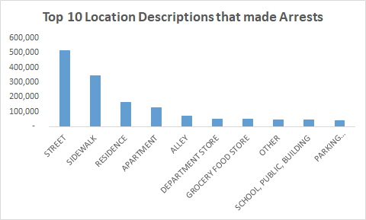
Data Statistics
Top 10 location description with most arrest
SELECT * FROM (
SELECT LOCATION_DESCRIPTION,COUNT(ARREST) AS TOTAL_ARREST
FROM CHICAGO
WHERE ARREST='TRUE'
GROUP BY LOCATION_DESCRIPTION
ORDER BY TOTAL_ARREST DESC)
WHERE ROWNUM <=10;

Slide 9
Data Quality Issues and Resolution
Issues
Using ID as the primary key causes duplicates
Resolution
Since we used case_number as primary key beforehand this did not cause any duplicates in our data table. Only thing we had to do was get rid of the null values from case_number which only had 4 missing values.
CREATE TABLE CHICAGO AS ( SELECT CASE_NUMBER, CRIME_DATE, BLOCK, IUCR, TYPE, DESCRIPTION, LOCATION_DESCRIPTION, ARREST, DOMESTIC, BEAT, DISTRICT, WARD, COMMUNITY_AREA, FBI_CODE, X_COORDINATE, Y_COORDINATE, YEAR, UPDATED_ON, LATITUDE, LONGITUDE, LOCATION
FROM CHICAGO
WHERE CASE_NUMBER IS NOT NULL
GROUP BY CASE_NUMBER, CRIME_DATE, BLOCK, IUCR, TYPE, DESCRIPTION, LOCATION_DESCRIPTION, ARREST, DOMESTIC, BEAT, DISTRICT, WARD, COMMUNITY_AREA, FBI_CODE, X_COORDINATE, Y_COORDINATE, YEAR, UPDATED_ON, LATITUDE, LONGITUDE, LOCATION );
Notes:
Since we made case_number our primary key when first generating table it created

Slide 10

Question 1:
Find the most dangerous and safe districts in Chicago (i.e., most and least crimes) and report their total crime counts.
SELECT DISTRICT, COUNT(*) AS CRIMES
FROM CHICAGO
GROUP BY DISTRICT
HAVING COUNT(*) = (
SELECT MAX(CRIMES)
FROM(
SELECT DISTRICT, COUNT(*) AS CRIMES
FROM CHICAGO
GROUP BY DISTRICT))
UNION
SELECT DISTRICT, COUNT(*) AS CRIMES
FROM CHICAGO
GROUP BY DISTRICT
HAVING COUNT(*) = (
SELECT MIN(CRIMES)
FROM(
SELECT DISTRICT, COUNT(*) AS CRIMES
FROM CHICAGO
GROUP BY DISTRICT));

Slide 11
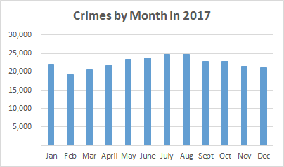
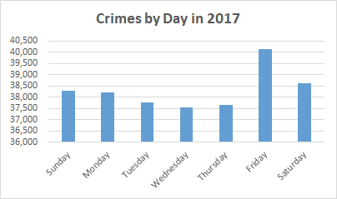
Question 2:
Analyze the monthly trend of crimes within a year and across different days of week.
SELECT
EXTRACT(MONTH FROM CRIME_DATE) AS CRIME_MONTH,
COUNT(*) AS CRIMES
FROM CHICAGO
WHERE EXTRACT(YEAR FROM CRIME_DATE) = 2017
GROUP BY EXTRACT(MONTH FROM CRIME_DATE)
ORDER BY CRIME_MONTH;
SELECT
TO_CHAR(CRIME_DATE, 'd') as CRIME_DAY,
COUNT(*) AS CRIMES
FROM CHICAGO
WHERE EXTRACT(YEAR FROM CRIME_DATE) = 2017
GROUP BY TO_CHAR(CRIME_DATE, 'd')
ORDER BY CRIME_DAY

Slide 12
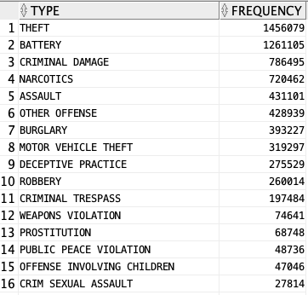
Question 3:
Rank different types of crimes based on total counts.
SELECT TYPE, COUNT(*) AS FREQUENCY
FROM CHICAGO
GROUP BY TYPE
ORDER BY FREQUENCY DESC;

Slide 13

First Part of Question 4:
Find the geographic range of crimes in the dataset and define a bounding box.
SELECT MIN(LATITUDE) AS MIN_LAT, MAX(LATITUDE) AS MAX_LAT,MIN(LONGITUDE) AS MIN_LONG,MAX(LONGITUDE) AS MAX_LONG
FROM CHICAGO;

Slide 14
Second Part of Question 4
Partition the bounding box into equally-sized grids (5km by 5km). Match each crime in the data to a grid cell with x and y coordinates. Add them as two new columns in the table.
UPDATE CHICAGO
SET X_COORDINATE = FLOOR((LONGITUDE + 91.69)/.045), Y_COORDINATE = FLOOR((LATITUDE - 36.62)/.045)
WHERE LATITUDE IS NOT NULL;
COMMIT;

Slide 15
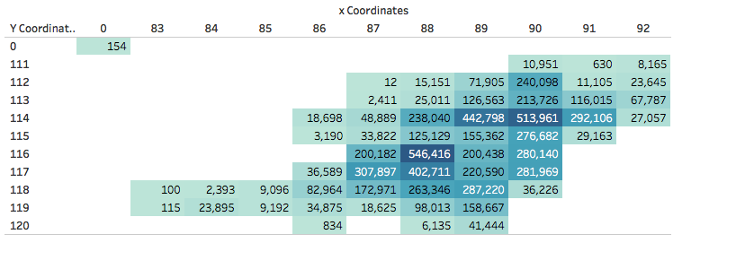
Question 5
Generate a heatmap of crime over the grid. First generate a table with 3 columns x, y, and count.
CREATE TABLE CRIME_OVER_GRID
AS (
SELECT X_COORDINATE, Y_COORDINATE, COUNT(*) AS TOTAL_COUNT
FROM CHICAGO
GROUP BY X_COORDINATE, Y_COORDINATE);
Notes:
x=88,y=116 most crimes

Slide 16
Question 7:
DECLARE
V_CRIME_LVL NUMBER;
V_AVG_CRIME_LVL NUMBER;
BEGIN
FOR i in 1..31
LOOP
FOR j in 0..23
LOOP
DECLARE
CURSOR C_CRIME IS(
SELECT X_COORDINATE, Y_COORDINATE, CRIME_DATE, SUM(CRIME_LVL) AS CRIME_LVL
FROM (
SELECT X_COORDINATE, Y_COORDINATE, CAST(CRIME_DATE AS DATE) AS CRIME_DATE,
CASE
WHEN ARREST = 'true' THEN 2
ELSE 1
END AS CRIME_LVL
FROM CHICAGO
WHERE EXTRACT(YEAR FROM CRIME_DATE) = 2002 AND EXTRACT(MONTH FROM CRIME_DATE) = 1 AND EXTRACT(DAY FROM CRIME_DATE) = i AND EXTRACT(HOUR FROM CRIME_DATE) = j AND X_COORDINATE IS NOT NULL)
GROUP BY X_COORDINATE, Y_COORDINATE, CRIME_DATE);
BEGIN
FOR V_CRIME IN C_CRIME
LOOP
INSERT INTO CRIME VALUES(V_CRIME.X_COORDINATE, V_CRIME.Y_COORDINATE, V_CRIME.CRIME_DATE, V_CRIME.CRIME_LVL);
SELECT SUM(CRIME_LVL)
INTO V_CRIME_LVL
FROM CRIME
WHERE X_COORDINATE = V_CRIME.X_COORDINATE AND Y_COORDINATE = V_CRIME.Y_COORDINATE AND CRIME_DATE BETWEEN V_CRIME.CRIME_DATE - 1 AND V_CRIME.CRIME_DATE ;
SELECT AVG(CRIME_LVL) AS AVG_CRIME_LVL
INTO V_AVG_CRIME_LVL
FROM (
SELECT X_COORDINATE, Y_COORDINATE, CRIME_DATE, SUM(CRIME_LVL) AS CRIME_LVL
FROM (
SELECT X_COORDINATE, Y_COORDINATE, CAST(CRIME_DATE AS DATE) AS CRIME_DATE,
CASE
WHEN ARREST = 'true' THEN 2
ELSE 1
END AS CRIME_LVL
FROM CHICAGO
WHERE X_COORDINATE = V_CRIME.X_COORDINATE AND Y_COORDINATE = V_CRIME.Y_COORDINATE)
GROUP BY X_COORDINATE, Y_COORDINATE, CRIME_DATE)
GROUP BY X_COORDINATE, Y_COORDINATE;
UPDATE GRID
SET CRIME_LVL = (V_CRIME_LVL/V_AVG_CRIME_LVL)
WHERE X_COORDINATE = V_CRIME.X_COORDINATE AND Y_COORDINATE = V_CRIME.Y_COORDINATE;
END LOOP;
END;
DBMS_OUTPUT.PUT_LINE('THE TOP 10 AREAS WITH THE HIGHEST CRIME LVL ON DAY ' || i || ' AND HOUR ' || j || ' ARE:');
DECLARE
CURSOR C_GRID IS (
SELECT X_COORDINATE, Y_COORDINATE, CRIME_LVL
FROM(
SELECT X_COORDINATE, Y_COORDINATE, CAST(CRIME_LVL AS VARCHAR(10)) AS CRIME_LVL
FROM GRID
WHERE CRIME_LVL IS NOT NULL
ORDER BY CRIME_LVL DESC)
WHERE ROWNUM <= 10);
BEGIN
FOR V_GRID IN C_GRID
LOOP
DBMS_OUTPUT.PUT_LINE('(' || V_GRID.X_COORDINATE || ',' || V_GRID.Y_COORDINATE || ') ' || 'WITH CRIME LEVEL OF: ' || V_GRID.CRIME_LVL);
END LOOP;
END;
END LOOP;
END LOOP;
END;
Critical level= number of crimes in last 24 hours / historical daily average crime count in same grid cell
Historical daily average crime count in same grid cell= number of total crimes in each grid/ total amount of days in each grid

Slide 17
Challenges
Data loading- Getting the correct SQL format for all of the data
Date and Time
Working remotely to complete the project
Figuring out the correct PL syntax to write question 7

Slide 18
Questions?

